Slide 1

Sequence modelling RNN, LSTM, GRU
Hongtu Zhu
Bios 7xx: Deep Learning Methods for Biomedical Applications with Pytorch

Slide 2


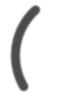




Graph Deep Learning for Spatiotemporal Time Series
Forecasting, Reconstruction and Analysis
Cesare Alippi, Daniele Zambon, Andrea Cini, Ivan Marisca
ECML/PKDD, Turin · September 22, 2023
Graph Machine Learning Group (gmlg.ch) The Swiss AI Lab IDSIA
Università della Svizzera italiana

Slide 3
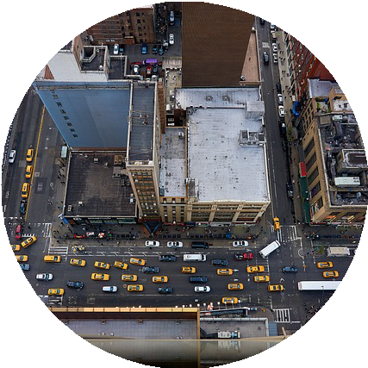


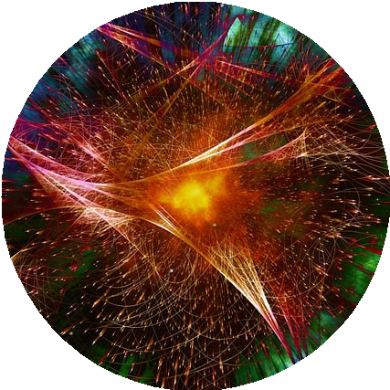

Traffic monitoring
Smart cities
Energy analitics
Physics
Stock markets

Slide 4
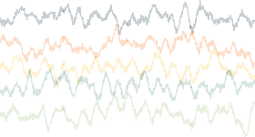
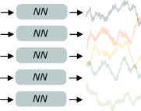
Deep learning for time series forecasting
The standard deep learning approach to time series forecasting consists in training a single neural network on a collection of time series.
Each time series is treated independently from the others.
A single set of shared learnable parameters is used to predict each time series.
Resulting models are effective and efficient.
A Dependencies across time series are often discarded.
[1] K. Benidis et al., “Deep Learning for Time Series Forecasting: Tutorial and Literature Survey”, ACM CS 2022.
2

Slide 5
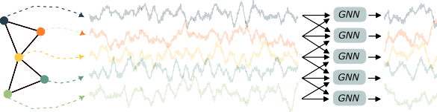
Relational inductive biases
One way out is to embed such relational structure as an architectural bias into the processing. Graph neural networks provide appropriate neural operators.
Message-passing blocks allow for localizing the predictions
→ conditioning on observations at related time series (neighboring nodes).
Parameters are shared and the model can operate on arbitrary sets of time series.
D. Bacciu et al., “A gentle introduction to deep learning for graphs”, NN 2020.
M. M. Bronstein et al., “Geometric deep learning: Grids, groups, graphs, geodesics, and gauges” 2021.
3

Slide 6
What this tutorial is about
This tutorial aims at merging two active and prominent research fields:
deep learning for time series and
deep learning on graphs.
We provide a unified exposition of the recent advancements in graph-based time series processing, highlighting challenges and pitfalls.
We offer researchers and practitioners a complete toolset of methodological guidelines, best practices, and software to exploit such framework in real-world problems.
A reference paper and Python notebook complement this presentation.
[4] A. Cini et al., “Graph Deep Learning for Time Series Forecasting: A Comprehensive Methodological Framework” 2023.

Slide 7
Tutorial outline
Part 1
Spatiotemporal time series
Spatiotemporal GNNs
Global and local models
Model quality assessment
> Software demo
� Conclusions
Part 2
Latent graph learning
Learning in non-stationary environments
Scalability
Dealing with missing data

Slide 8
Part 1
Graph-based Processing of Spatiotemporal Time series

Slide 9
Spatiotemporal time series

Slide 10
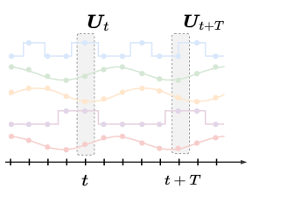
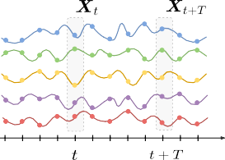
Collections of time series
Spatiotemporal time series
We consider a set of N correlated time series, where each i-th time series is associated with:
i d
an observation vector x ∈ R at each time step t;
t
x
i d
a vector of exogenous variable u ∈ R at each time step t;
t
u
a vector of static (time-independent) attributes v^{i} ∈ R^{dv} .
time time
Capital letters denote the stacked representations encompassing the N time series in the collection, e.g., X_{t} ∈ R^{N ×dx} , U_{t} ∈ R^{N ×du} .
[4] A. Cini et al., “Graph Deep Learning for Time Series Forecasting: A Comprehensive Methodological Framework” 2023.
6

Slide 11
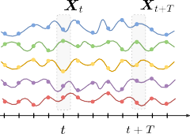
Correlated time series
Spatiotemporal time series
We assume a time-invariant stochastic process
t )
i i i
x ∼ p x X , U , V
t t <t ≤t
i
generating the data x for all i = 1 . . . N and t ∈ N.
time
t
Note that the time series:
can be generated by different processes,
can depend on each other,
are assumed
homogenous, synchronous, regularly sampled.
Notation:
X_{t:t+T} = [X_{t}, · · · , X_{t+T −1}]
X_{<t} = [X₀, · · · , X_{t−2}, X_{t−1}]
→ These assumptions can be relaxed, as we will discuss in the 2nd part.

Slide 12

Relational information
Spatiotemporal time series
We assume the existence of functional dependencies between the time series.
→ e.g., forecasts for one time series can be improved by
accounting for the past values of other time series.
time
We model pairwise relationships existing at time step t with adjacency matrix A_{t} ∈ {0, 1}^{N ×N} .
A_{t} can be asymmetric and dynamic (can vary with t).
→ We call spatial the dimension spanning the time series collection.

Slide 13
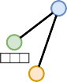
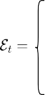
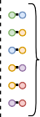
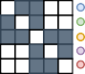

Relational information with attributes
Spatiotemporal time series
ij
d
Optional edge attributes e ∈ R can be associated to each non-zero entry of A .
e
t t
The set of attributed edges encoding all the available relational information is denoted by
.
ij
E_{t} = {⟨(i, j), e_{t} ⟩ | ∀i, j : A_{t}[i, j] ̸= 0}.
→ For many applications, A_{t} changes slowly over time and can be considered as constant within a short window of observations.

Slide 14
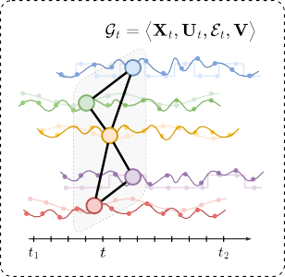
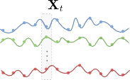
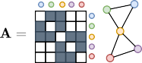
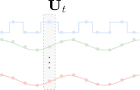

Spatiotemporal time series
Spatiotemporal time series
time
We use the terms node and sensor to indicate the N entities generating the time series.
→ We refer to the node set together with the relational information as sensor network.
.
The tuple G = ⟨X , U , E , V ⟩ contain all the available information associated with time step t.
t
t t t

Slide 15

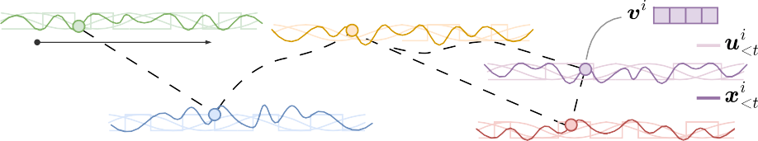
Example: Traffic monitoring system
Spatiotemporal time series
Consider a sensor network monitoring the speed of vehicles at crossroads.
time
X_{<t} collects past traffic speed measurements.
U_{t} stores identifiers for time-of-the-day and day-of-the-week.
V collects static sensor’s features, e.g., type or number of lanes of the monitored road.
E can be obtained by considering the road network.
– Road closures and traffic diversions can be accounted for with a dynamic topology Et.

Slide 16
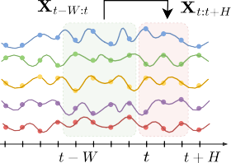
Time series forecasting
Spatiotemporal time series
Multi-step time-series forecasting
Given a window of W ≥ 1 past observations
X_{t−W :t} = [X_{t−W} , . . . , X_{t−1}],
predict H ≥ 1 future observations
_{x}i
, i = 1 · · · N, h = 1 · · · H.
time
t+h
In particular, we are interested in learning a parametric model p_{θ} approximating the unknown data distribution p
t ) t
i
i i
p x X
, U , V ≈ p x X_{<t}, U_{≤t+h}, V ⁾ .
θ t+h t−W :t t−W :t+h
t+h
θ is the model parameter vector.
12

Slide 17
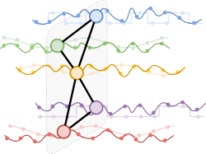
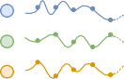
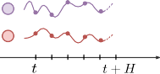
Time series forecasting + relational inductive biases
Spatiotemporal time series
Condition the model on the relational information E_{t−W :t}
t
p x
i
Gt−W :t, Ut−W :t+h, V ⁾
θ
t+h
Gt−W :t
Xt:t+H
Forecasts
time
time
The conditioning on the sequence of attributed graphs acts as a regularization to localize predictions w.r.t. the neighborhood of each node.
W

Slide 18
Point forecasts
Spatiotemporal time series
For simplicity, we focus here on point forecasts, rather than the modeling of full data distributions p, and consider predictive model
i
x� = F (G
, U ; θ)
t+h
t−W :t t:t+h
[ ].
i
i
where x� approximates, e.g., E x
p
t+h t+h
Parameters θ can be learned by minimizing a cost function ℓ( · , · ) (e.g., MSE) on a training set
T
( )
1
NT
I:
�
θ = arg min
ℓ
X⁻⁻⁻⁻t:t+H , Xt:t+H
θ
t=1
I:
1
T
1
1
2
= arg min X
NT ¹
----
− X
.
1
t:t+H t:t+H
θ
t=1
2

Slide 19
Spatiotemporal
Graph Neural Networks

Slide 20
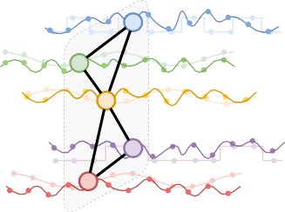
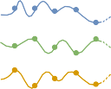
Spatiotemporal Graph Neural Networks
Spatiotemporal Graph Neural Networks
We call Spatiotemporal Graph Neural Network (STGNN) a neural network exploiting both temporal and spatial relations of the input spatiotemporal time series.
X⁻⁻⁻⁻t:t+H
G<t
STGNN Predictor
time
t
time
We focus on models based on message passing.

Slide 21
Message-passing neural networks
Spatiotemporal Graph Neural Networks
To process the spatial dimension, we rely on the message-passing (MP) framework
( {
t )
o)
i,l+1 l i,l l i,l j,l ji
h = UP h , AGGR MSG h , h , e ,
(1)
j∈N (i)
Where:
MSG^{l}( · ) is the message function, e.g., implemented by an MLP.
AGGR{ · } is the permutation invariant aggregation function.
UP^{l}( · ) is the update function, e.g., implemented by an MLP.
Aggregation is performed over N (i), i.e., the set of neighbors of node i.
[5] J. Gilmer et al., “Neural message passing for quantum chemistry”, ICML 2017.

Slide 22





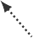




Message passing in action
Spatiotemporal Graph Neural Networks
_{h}4,l
_{e}41
_{MSG}41,l
{
}
_{h}1,l
_{h}1,l+1
_{e}31
_{MSG}31,l
_{e}21
_{MSG}21,l
_{h}3,l
_{h}2,l
Message
Aggregate
Update

Slide 23
Spatiotemporal message passing
Spatiotemporal Graph Neural Networks
Starting from the MP framework, we can define a general scheme for spatiotemporal message-passing (STMP) networks:
(
{ o
t )
i,l+1 l i,l l
i,l
j,l ji
h = UP h , AGGR MSG h , h , e
t ≤t
≤t ≤t
^{≤t} j∈N (i)
t
Rather than vectors, STMP blocks process sequences.
→ STMP blocks must be implemented with operators that work on sequences! We will look at different implementations of STMP blocks in the following.
[4] A. Cini et al., “Graph Deep Learning for Time Series Forecasting: A Comprehensive Methodological Framework” 2023.

Slide 24
A general recipe
Spatiotemporal Graph Neural Networks
We consider STGNNs can be expressed as a sequence of three operations:
_{h}i,0
t
i
= ENCODER x , u^{i} , v^{i)} ,
(2)
(3)
(4)
t−1
(
t−1 t−1
l+1
l l
H = STMP H
≤t−1^{, E}≤t−1^{),}
l = 0, . . . , L − 1
t−1
(
) .
xˆ^{i}
i,L i
= DECODER h , u
t:t+H
t−1 t:t+H
Where:
ENCODER( · ) is the encoding layer, e.g., implemented by an MLP.
STMP is a stack of STMP layers.
DECODER( · ) is the readout layer, e.g., implemented by an MLP.

Slide 25
Framework overview
Spatiotemporal Graph Neural Networks
_{u}i
, v^{i}
_{u}i
t−W :t
t:t+H
STMP^{L}
_{x}i
ENCODER
_{h}i,0
_{h}i,L
DECODER
xˆ^{i}
t−W :t
t−W :t
t−1
t:t+H
STMP¹
.
MP between time series
.
.
.
STMP^{L}
_{x}j
ENCODER
_{h}j,0
_{h}j,L
DECODER
xˆ^{j}
t−W :t
t−W :t
t−1
t:t+H
STMP¹
_{u}j
, v^{j}
_{u}j
t−W :t
t:t+H

Slide 26
Design paradigms for STGNNs
Spatiotemporal Graph Neural Networks
Depending on the implementation of the STMP blocks, we categorize STGNNs into:
Time-and-Space (T&S)
Temporal and spatial processing cannot be factorized in two separate steps.
Time-then-Space (TTS)
Embed each time series in a vector, which is then propagated over the graph.
Space-then-Time (STT)
Propagate nodes features at first and then process the resulting time series.
_{x}i
STMP^{L} STMP¹
xˆ^{i}
t−W :t
ENCODER
DECODER
t:t+H

Slide 27
Time-and-Space
Spatiotemporal Graph Neural Networks / Architectures
In T&S models, representations at every node and time step are the results of a joint temporal and spatial encoding
(
l+1 l l
H = STMP H
, E≤t−1⁾
t−1 ≤t−1
Several options exist.
Integrate MP into neural operators for sequential data.
Graph recurrent architectures, spatiotemporal convolutions, spatiotemporal attention, ...
Use temporal operators to compute messages.
Temporal graph convolutions, spatiotemporal cross-attention, ...
Product graph representations.

Slide 28
Example 1: From Recurrent Neural Networks...
Spatiotemporal Graph Neural Networks / Architectures
Consider a standard GRU [6] cell.
t [
] _{+ br})
r = σ Θ x ||
i
i
h
i
(5)
(6)
(7)
(8)
t
r t t−1
t [
] _{+ bu})
u = σ Θ x ||
i
i i
u
h
t
t t−1
t [
] _{+ bc})
c = tanh Θ x ||
i
i i i
c
r ⊙ h
t
t t t−1
t )
i
i i
i i
h = 1 − u ⊙ c + u ⊙ h
t t t t t−1
Time series can be processed independently for each node or as a single multivariate time series.
[6] J. Chung et al., “Empirical evaluation of gated recurrent neural networks on sequence modeling” 2014.

Slide 29
...to Graph Convolutional Recurrent Neural Networks
Spatiotemporal Graph Neural Networks / Architectures
We can obtain a T&S model by implementing the gates of the GRU with MP blocks:
_{Z}l _{= H}l−1
(9)
(10)
(11)
(12)
(13)
t t
t t[
] _{, Et})) ,
l
l l
l
R = σ MP Z ||
H
t
r t
t−1
t t[
] _{, Et})) ,
l
l l
l
O = σ MP Z ||
H
t
o t t−1
t t[
] _{, Et})) ,
l
l l
l l
C = tanh MP Z ||
R ⊙ H
t
c t
t t−1
l
l l
l
l
H = O ⊙ H + (1 − O ) ⊙ C ,
t
t t−1
t t
These T&S models are known as graph convolutional recurrent neural networks (GCRNNs) [7].
[7] Y. Seo et al., “Structured sequence modeling with graph convolutional recurrent networks”, ICONIP 2018.
24

Slide 30
Popular GCRNNs
Spatiotemporal Graph Neural Networks / Architectures
The first GCRNN has been introduced in [7], with MP blocks implemented as polynomial graph convolutional filters.
GCRNNs have become popular in the traffic forecasting context with the Diffusion Convolutional Recurrent Neural Network (DCRNN) architecture [8].
In DCRNN, MP is performed through bidirectional diffusion convolution:
I:
( )_{k}
K
t )_{k}
_{D}−1 _{At}
(k)
_{D}−1 _{A}⊤
(k)
H′ =
H_{t}Θ +
H_{t}Θ
(14)
t
t,out
1
t,in t
2
k=0
Y. Seo et al., “Structured sequence modeling with graph convolutional recurrent networks”, ICONIP 2018.
Y. Li et al., “Diffusion Convolutional Recurrent Neural Network: Data-Driven Traffic Forecasting”, ICLR 2018.

Slide 31
Example 2: Spatiotemporal convolutional networks (i)
Spatiotemporal Graph Neural Networks / Architectures
A completely different approach is that of spatiotemporal convolutional networks (STCNs), that
alternate spatial and temporal convolutional filters:
Compute intermediate representations by using a node-wise temporal convolutional layer:
( )
_{z}i,l
l i,l−1
= TCN h ∀ i
t−W :t t−W :t
where TCN^{l} indicates a temporal convolutional network layer.
Then, compute the updated representation by using a time-wise graph convolution:
t )
l l l
H = MP Z , E
∀ t
t
t t

Slide 32
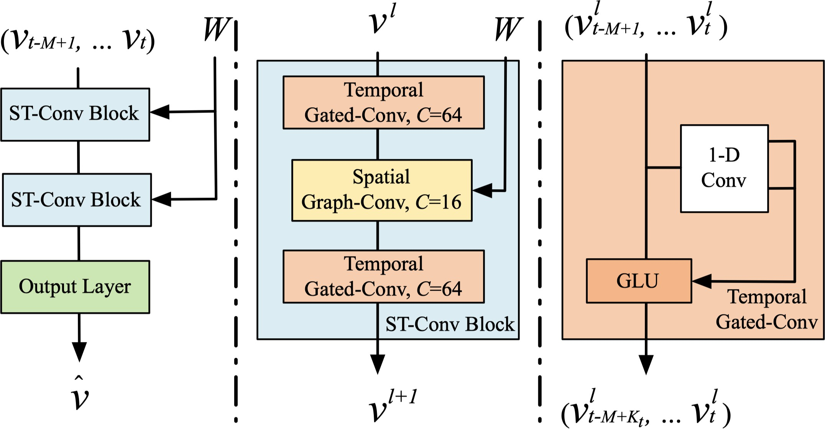
Spatiotemporal convolutional networks (ii)
Spatiotemporal Graph Neural Networks / Architectures
The first example of such architecture is the STGCN by Yu et al. [9].
The model is obtained by stacking STMP blocks consisting of
a (gated) temporal convolution;
a polynomial graph convolution;
a second (gated) temporal convolution.
Courtesy of [9].
[9] B. Yu et al., “Spatio-temporal graph convolutional networks: a deep learning framework for traffic forecasting”, IJCAI 2018.

Slide 33
Example 3: Temporal Graph Convolution
Spatiotemporal Graph Neural Networks / Architectures
A more integrated approach instead consists of using temporal operators to compute messages. For example, we can design STMP layers s.t.
(
{ ( )o .
_{h}i,l
l i,l−1
l i,l−1 j,l−1 ji
= TCN h , AGGR TCN h , h , e
t−W :t 1
^{t−W :t} j∈N (i)
2 t−W :t t−W :t t−W :t
t
Analogous models can be built by exploiting attention-based operators [10], [11].
[10] I. Marisca et al., “Learning to Reconstruct Missing Data from Spatiotemporal Graphs with Sparse Observations”, NeurIPS 2022.
[11] Z. Wu et al., “TraverseNet: Unifying Space and Time in Message Passing for Traffic Forecasting”, TNNLS 2022.
28

Slide 34
Example 4: Product graph representations
Spatiotemporal Graph Neural Networks / Architectures
Finally, an orthogonal option to those seen so far is to consider G_{t−W :t} as a single spatiotemporal graph S_{t}.
Such product graph can be obtained by combining temporal and spatial graphs.
Temporal graph:
· · ·
Spatial graph:
t − W t − 2 t − 1
The resulting graph can be processed by any MP neural network.
[12] M. Sabbaqi et al., “Graph-time convolutional neural networks: Architecture and theoretical analysis” 2022.
29

Slide 35
Building product graph representations
Spatiotemporal Graph Neural Networks / Architectures
Cartesian product
Spatial graphs are kept and each node is connected to itself in the previous time instant.
Kronecker product
Each node is connected only to its neighbors in the previous time instant.
...

Slide 36
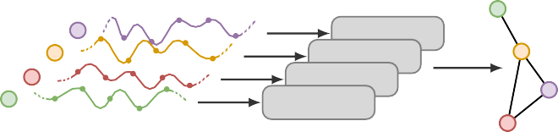
Time-then-Space models
Spatiotemporal Graph Neural Networks / Architectures
The general recipe for a TTS model consists in:
Embedding each node-level time series in a vector.
Propagating obtained encodings throughout the graph with a stack of MP layers.
( )
t )
1. h
i,1 t
= SEQENC h
i,0 l+1
l l
2. H = MP H , E
≤t
t
t t
SEQENC SEQENC
SEQENC SEQENC
MP^{L}
MP² MP¹
_{H}L
t
_{H}0 _{t}
t
)
≤
1
H_{t} , A

Slide 37
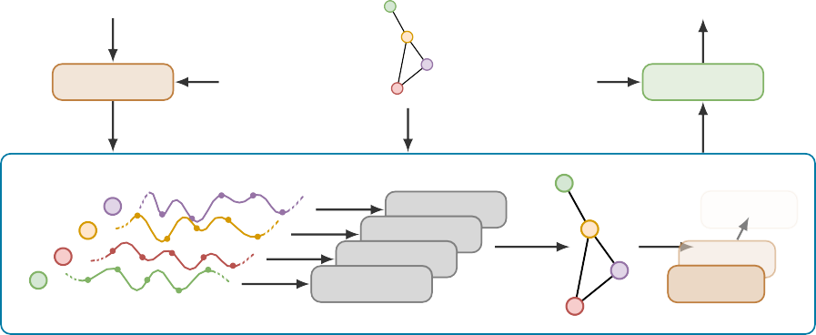
Full TTS model
Spatiotemporal Graph Neural Networks / Architectures
Xt−W :t
E
X⁻⁻⁻⁻t:t+H
DECODER
ENCODER
Ut−W :t
Ut:t+H
SEQENC SEQENC
SEQENC SEQENC
MP^{L}
MP² MP¹
STMP

Slide 38
Pros & Cons of TTS models
Spatiotemporal Graph Neural Networks / Architectures
⌣ Easy to implement and computationally efficient.
⌣ We can reuse operators we already know.
⌢ The 2-step encoding might introduce information bottlenecks.
⌢ Accounting for changes in topology and dynamic edge attributes can be more problematic.
Pros:
Cons:

Slide 39
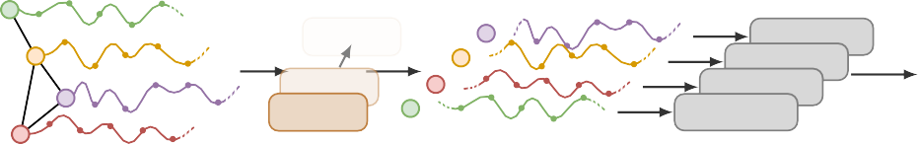
Space-then-Time
Spatiotemporal Graph Neural Networks / Architectures
In STT approaches the two processing steps of TTS models are inverted:
Observations are propagated among nodes w.r.t. each time step using a stack of MP layers.
Each sequence of representations is processed by a sequence encoder.
( ) ( )
i,l l i,l−1
i,L i,L−1
t t−W :t
1. H = MP H , E
2. h
= SEQENC h
t
t t
MP^{L}
MP² MP¹
SEQENC SEQENC
SEQENC
SEQENC
_{H}L
t
_{H}L−1
i,0
t−W :t
H_{t−W :t}, Et−W :t
⌢ They do not have the same computational advantages of TTS models.

Slide 40
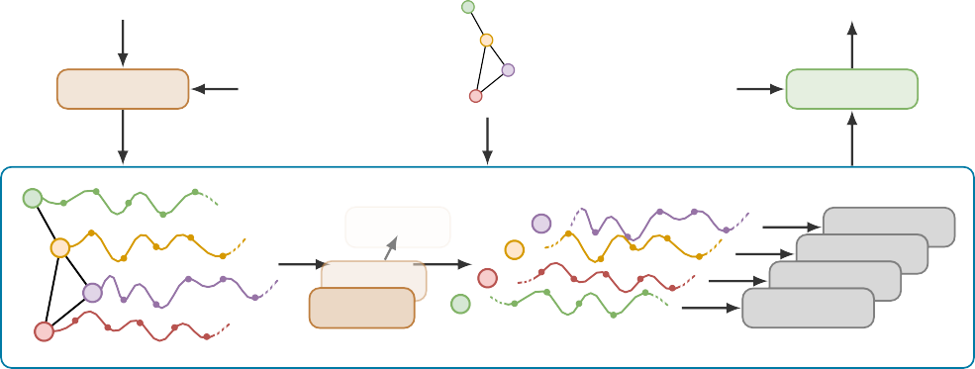
Full STT model
Spatiotemporal Graph Neural Networks / Architectures
Xt−W :t
E
X⁻⁻⁻⁻t:t+H
DECODER
ENCODER
Ut−W :t
Ut:t+H
MP^{L}
MP² MP¹
SEQENC SEQENC
SEQENC SEQENC
STMP

Slide 41
Global and local models

Slide 42
Global vs local
Global and local models
A forecasting model is called global if its parameters are fitted to a group of time series
→ either univariate or multivariate.
Conversely, local models are specific to a single (possibly multivariate) time series.
Global model Local models
x^{i} F_{G} xˆ^{i} x^{i}
F_{G}
f_{i} xˆ^{i}
t−W :t
t:t+H t−W :t
t:t+H
_{x}j
xˆ^{j}
_{x}j
fj xˆ^{j}
t−W :t
t:t+H
t−W :t
t:t+H
A global model does not have any time-series-specific (local) parameters.
[13] P. Montero-Manso et al., “Principles and algorithms for forecasting groups of time series: Locality and globality”, IJF 2021.

Slide 43
Trade-offs
Global and local models
Global models
Just a single model needs to be trained and maintained.
Larger amount of data available for training.
Can be used in inductive learning scenarios (on unseen target time series).
Theoretically, it can be as expressive as fitting a set of local models to each time series.
Local models
Can more easily model time-series-specific dynamics.
Often require shorter input windows.
No problem in dealing with heterogeneous/asynchronous time series.
37

Slide 44
Globality and locality in STGNNs
Global and local models
STGNNs are typically global models: they do not rely upon node-specific parameters.
→ But they condition representations on each node’s neighborhood, thus accounting for
spatial dependencies.
Nonetheless, entirely global models might struggle to model local effects¹ and might require:
⌢ impractically long observation windows;
⌢ large model capacity.
'Q We can use hybrid global-local STGNNs with specialized local components.
¹ Dynamics proper of each time series in the collection.
[14] A. Cini et al., “Taming Local Effects in Graph-based Spatiotemporal Forecasting”, To appear in NeurIPS 2023.

Slide 45



Global-local STGNNs (Example 1)
Global and local models
A simple approach consists of combining a global model and a (simpler) local one:
F_{G}
i,(1)
^{xˆ}t:t+H
_{x}i
+
xˆ^{i}
t−W :t
t:t+H
f_{i}
_{xˆ}i,(2)
t:t+H
.
.
.
.
F_{G}
j,(1)
^{xˆ}t:t+H
_{x}j
+
xˆ^{j}
t−W :t
t:t+H
f_{j}
_{xˆ}j,(2)
t:t+H

Slide 46
Global-local STGNNs (Example 2)
Global and local models
i
Another possibility is to use different weights for each time series at the encoding (ω ) and
enc
i
decoding (ω ) steps:
dec
t )
( )
i,0
i
i,L i
h = ENCODER x , u^{i} , v^{i}; ω^{i}
xˆ^{i} = DECODER h , u ; ω
t i t−1 t−1 enc t:t+H i t t:t+H dec
. . . . . . . . . . . . . . . . . . . . . . . . . . . . . . . . . . . . . . . . . . . . . . . . . . . . . . . . . . . . . . . . . . . . . . . . . . . . . . . . . . . . . . . . . .
_{u}i _{u}i
, v^{i}
t−W :t t:t+H
STMP^{L}
STMP¹
_{x}i
ENCODER_{i}
enc
_{h}i,0
_{h}i,L
DECODER_{i}
dec
xˆ^{i}
t−W :t
t−W :t
t−1
t:t+H
_{ω}i
_{ω}i

Slide 47
Global-local STGNNs (Example 2)
Global and local models
_{u}i
, v^{i}
_{u}i
t−W :t
t:t+H
STMP^{L}
_{x}i
ENCODER
enc
_{h}i,0
_{h}i,L
DECODER
dec
xˆ^{i}
t−W :t
t−W :t
t−1
t:t+H
_{ω}i
STMP¹
_{ω}i
.
MP between time series
.
.
.
_{ω}j
_{ω}j
enc
STMP^{L}
dec
_{x}j
ENCODER
_{h}j,0
_{h}j,L
DECODER
xˆ^{j}
t−W :t
t−W :t
t−1
t:t+H
STMP¹
_{u}j
, v^{j}
_{u}j
t−W :t
t:t+H

Slide 48
Pros & Cons of global-local STGNNs
Global and local models
How to balance between the global and local modeling paradigms is problem-dependent. Introducing local components specific to each time series in a global STGNN has several effects.
⌣ Node-level effects are captured more efficiently than by fully global models.
⌣ Forecasting accuracy on the task is usually higher empirically.
⌢ The model’s inductive capabilities are compromised (hard to handle unseen time series).
⌢ The number of learnable parameters can be much larger compared to fully global models.
We can mitigate these two drawbacks by associating each node with a learnable embedding.
W

Slide 49
Learnable node embeddings
Global and local models
Node embeddings are a table of learnable parameters
Q ∈ R^{N ×dq} associated with each node.
They can be fed into modules of a global STGNN and learned end-to-end.
. . . . . . . . . . . . . . . . . . . . . . . . . . . . . . . . . . . . . . . . . . . . . . . . . . . . . . . . . . . . . . . . . . . . . . . . . . . . . . . . . . . . . . . . . .
Example: node embeddings can be used to condition the encoding and decoding steps:
t
(
i,0 i i,L
i
h = ENCODER x , u^{i} , v^{i}, q^{i)}
xˆ^{i} = DECODER h , u , q^{i)}
t
t−1 t−1
t:t+H
t t:t+H
Note: all the weights of the ENCODER and DECODER modules can be shared among all the nodes.
[14] A. Cini et al., “Taming Local Effects in Graph-based Spatiotemporal Forecasting”, To appear in NeurIPS 2023.

Slide 50
Node embeddings in action
Global and local models
_{u}i
, v^{i}, q^{i}
_{u}i
, q^{i}
t−W :t
t:t+H
STMP^{L}
_{x}i
ENCODER
_{h}i,0
_{h}i,L
DECODER
xˆ^{i}
t−W :t
t−W :t
t−1
t:t+H
STMP¹
.
MP between time series
.
.
.
STMP^{L}
_{x}j
ENCODER
_{h}j,0
_{h}j,L
DECODER
xˆ^{j}
t−W :t
t−W :t
t−1
t:t+H
STMP¹
_{u}j
, v^{j}, q^{j}
_{u}j
, q^{j}
t−W :t
t:t+H

Slide 51
Advantages of node embeddings
Global and local models
Using node embeddings to make an STGNN global-local allows us to:
Amortize the cost of specializing the model to each time series;
A single dq -dimensional vector for each node is added to the model’s parameters;
The same vector can be used in multiple components of the architecture.
Transfer the learned model to a different set of time series V′ more easily.
Only |V′|dq parameters need to be tuned, while the shared components are fixed;
The embedding space can be regularized to better fit embeddings of new nodes [14].
[14] A. Cini et al., “Taming Local Effects in Graph-based Spatiotemporal Forecasting”, To appear in NeurIPS 2023.

Slide 52
Example: global-local TTS
Global and local models
As an example, one can build a global-local TTS model by simply exploiting node embeddings and global RNN and MP layers as
t
i,0 i
h = ENCODER x , u^{i} , v^{i}, q^{i)} ,
t
( )
t−1 t−1
i,1
i,0
h = RNN h ,
t
≤t
(
l+1
l l
H = MP H
, E≤t−1⁾,
l = 1, . . . , L − 1
t
<t−1
(
xˆ^{i}
i,L i
= DECODER h , u , v^{i}, q^{i)} .
t:t+H
t−1 t:t+H

Slide 53
Global and local models
Some empirical results
Models |  | GPVAR-Global (MAE) GPVAR-Local (MAE)
Local | FC-RNN Local RNNs | .4393±.0024 | .5978±.0149
 |  | .4047±.0001 | .4610±.0003
Global | RNN RNN+MP | .3999±.0000 | .5440±.0003
 |  | .3193±.0000 | .3587± .0049
Global-local (w/ Emb.) | RNN RNN+MP | .3991±.0001 | .4612±.0003
 |  | .3194±.0001 .3199±.0001
Optimal model |  | .3192 .3192
Global models can fall short in certain scenarios.
Local multivariate models can easily overfit.
Global-local models can strike a good compromise.

Slide 54
Model quality assessment

Slide 55
Questions to answer
Model quality assessment
Consider a predictor F trained to solve a time-series forecasting problem.
Is the predictor optimal for the problem at hand?
Where does the predictor appear sub-optimal?
How can we improve the predictor?
Remark: Multiple optimality criteria can be considered.
W
Relational inductive biases can help us here too.

Slide 56
Performance at task
Model quality assessment
Consider predictors F_{a}, F_{b} from a set F of models and performance metric M (e.g., MAE, MSE).
we consider F_{a} better than F_{b} if M (F_{a}) is statistically better than M (F_{b}).
we consider F_{a} optimal if there is no F_{b} ∈ F better than F_{a}.
Model | M
F_{a} F_{b} | 0.145±0.002 0.176±0.005
.
F_{n} | 0.158±0.004
F∗ | 0.139±0.001
Can we further improve over the best model so far F ?
a
→ Either we find a new model F∗ better than F_{a}
→ or we need prior knowledge about the modeled system.

Slide 57
Residual correlation analysis
Model quality assessment
Studying the correlation between prediction residuals model optimality.
If residuals are dependent
_{i} .
i
i
^{r}t ^{= x}t:t+H
− xˆ allows for testing
t:t+H
=⇒ there is information that the model hasn’t captured
=⇒ model predictions can be improved.
Serial correlation
Correlation between residuals at differ- ent time steps.
Spatial correlation
Correlation between residuals at differ- ent graph nodes.
Most of the research focused on either serial correlation [15]–[17] or spatial correlation [18], [19].

Slide 58
Statistical tests for residual correlation
Model quality assessment
Whiteness test
H₀ : residuals are uncorrelated H₁ : some residuals correlate
Define a test statistic C({r }
i i
) = C(F, {x }) and a threshold γ such that
t
t
i
If |C({r }
)| > γ =⇒ reject H .
t
0
Remarks: Residual correlation analysis
⌣ Is independent of specific performance measures.
⌢ Does not quantify how much a model can improve w.r.t. a specific performance metric.
⌣ Does not rely on comparisons with other models.

Slide 59
AZ-Whiteness test: a spatio-temporal test
Model quality assessment
The test is defined by statistic
I: I:
I: I:
C({r}) =
i
j
i i
w sgn(⟨r , r ⟩) +
w sgn(⟨r , r ⟩)
ijt t t
it t t+1
|
t
(i,j)∈Et
} |
t i
}
spati..a,.l edge
tempo..r,.al edge
distribution-free and residuals can be non-identically distributed.
computation is linear in the number of edges and time steps.
[20] D. Zambon et al., “AZ-whiteness Test: A Test for Signal Uncorrelation on Spatio-Temporal Graphs”, NeurIPS 2022.

Slide 60





Where can we improve?
Model quality assessment
Analyzing the AZ-whiteness test statistic computed on subgraphs of the spatio-temporal graph allows for discovering insightful correlation patterns.
Spatial (or temporal) edges
Edges related to a node
Edges related to a time step
Edges related to a node
[21] D. Zambon et al., “Where and How to Improve Graph-based Spatio-temporal Predictors” 2023.

Slide 61
Challenges
Part 2

Slide 62
Challenges
Challenges
Latent graph learning
What to do when the underlying graph is not known?
Learning in non-stationary environments
What to do when the environment changes?
Scalability
How to deal with large collections of time series?
Dealing with missing data
How to deal with missing observations within the time series?

Slide 63
Latent graph learning

Slide 64
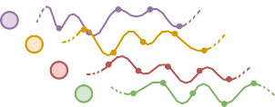
Learning and adjacency matrix
Latent graph learning
⌢ Relational information is not always available
⌢ or might be ineffective in capturing spatial dynamics.
⌣ Relational architectural biases can nonetheless be exploited
→ extract a graph from the time series or node attributes
X≤t
_{A}-
Graph extraction
It can be interpreted as regularizing a spatial attention operator.
[22] A. Cini et al., “Sparse graph learning from spatiotemporal time series”, JMLR 2023.

Slide 65
Time-series similarities
Latent graph learning
Probably, the simplest approach to extract a graph from the time series is by computing time series similarity scores.
Pearson correlation
Correntropy
Granger causality
Kernels for time series
. . .
→ Thresholding might be necessary to obtain binary and sparse graphs.

Slide 66
Latent graph learning
Latent graph learning
An integrated approach: learn the relations end-to-end with the downstream task
as a function of the input data,
as trainable parameters of the model,
or both.
This problem is known as latent graph learning (or latent graph inference). Two different approaches:
2.^{1.} learning^{learning} a^{dir}probability^{ectly an adjac}tributiondis ^{ency matrix}ervo ^{A-}graphs^{∈ RN ×}p^{N}_{Φ};generating A
-.
-
A One key challenge is keeping both A and the subsequent computations sparse.
→ challenging with gradient-based optimization.

Slide 67
Direct approach
Latent graph learning
-
A direct approach consists in learning A as function ξ(
· ) of edge
scores Φ ∈ R^{N ×N} as
Edge scores Φ
A⁻ = ξ (Φ)
→ can be a table of learnable model parameters,
→ obtained as a function of the inputs and/or other parameters.
Function ξ( · ) is a nonlinear activation
→ it can be exploited to make A⁻ sparse.

Slide 68
Direct approach: factorization methods
Latent graph learning
-
Many of the methods directly learning A, learn a factorization of the former to amortize the cost
of the inference:
A⁻ = ξ (Φ)
Φ = Z_{s}Z⊤
t
with
Z_{s} ∈ R^{N ×d} source node embeddings
Z_{t} ∈ R^{N ×d} target node embeddings
Z_{s} and Z_{t} can be learned as tables of (local) parameters or as a function of the input window.
[23] Z. Wu et al., “Graph wavenet for deep spatial-temporal graph modeling”, IJCAI 2019.

Slide 69
Pro & Cons of the direct approach
Latent graph learning
⌣ Easy to implement.
⌣ Many possible parametrizations.
⌣ Edge scores are usually easy to learn end-to-end.
⌢ It often results in dense computations with O(N ²) complexity.
-
⌢ Sparsifying A results in sparse gradients.
⌢ Encoding prior structural information requires smart parametrizations.

Slide 70
Probabilistic methods
Latent graph learning
-
In this context, probabilistic methods aim at learning a parametric distribution p for A by minimizing
Φ
L(Φ) = E_{Ab∼pΦ} ^{h}ℓ ⁽X⁻⁻⁻⁻_{t:t+H} , X_{t:t+H} ^{)L} .
(15)
Again, we can factorize Φ and make p_{Φ} input dependent, e.g.,
t )
-
Φ = ξ Z Z
⊤
t Φ <t <t
s
A ∼ p (A|X , U , V )
Different parametrizations of p_{Φ} allow for embedding sparsity priors on the sampled graphs [22].
A Gradient-based optimization requires ∇_{Φ}L(Φ)
→ it can be challenging and computationally expensive.
[22] A. Cini et al., “Sparse graph learning from spatiotemporal time series”, JMLR 2023.

Slide 71
Monte Carlo gradient estimators
Latent graph learning
-
'Q One approach is to reparametrize A ∼ p
Φ
(A) as: A⁻ = g (Φ, ε) ,
ε ∼ p(ε)
h L
decoupling parameters Φ from the random component ε: ∇_{Φ}L(Φ) = E_{ε} ∇_{Φ}ℓ(X⁻⁻⁻⁻, X) .
⌣ Practical and easy to implement,
⌢ rely on continuous relaxations and make subsequent computations scale with O(N ²).
'Q Conversely, score-function (SF) gradient estimators rely on the relation
h L h L
---- ----
∇ E ℓ(X, X) = E ℓ(X, X)∇ log p
Φ p
p
Φ Φ
Φ Φ
⌢ suffer from high variance (use variance reduction techniques),
⌣ allow to keep computations sparse.
→ we can use Monte Carlo estimator.
[24] T. Kipf et al., “Neural relational inference for interacting systems”, ICML 2018.
[22] A. Cini et al., “Sparse graph learning from spatiotemporal time series”, JMLR 2023.

Slide 72
Learning in
Non-Stationary Environments

Slide 73
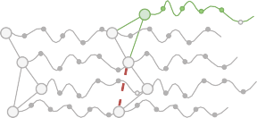
Inductive learning
Learning in Non-Stationary Environments
In real-world applications, one often needs to
operate under changes in the network connectivity
make predictions for newly added nodes
transfer the model to different sensor networks (collections of time series)
Useful in several tasks, like, forecasting, missing data imputation, and virtual sensing.
A Performance can easily degrade if the data distribution of target nodes
deviates from that at training nodes
changes over time.
[25] G. Ditzler et al., “Learning in Nonstationary Environments: A Survey”, IEEE CIM 2015.
[14] A. Cini et al., “Taming Local Effects in Graph-based Spatiotemporal Forecasting”, To appear in NeurIPS 2023.
63

Slide 74
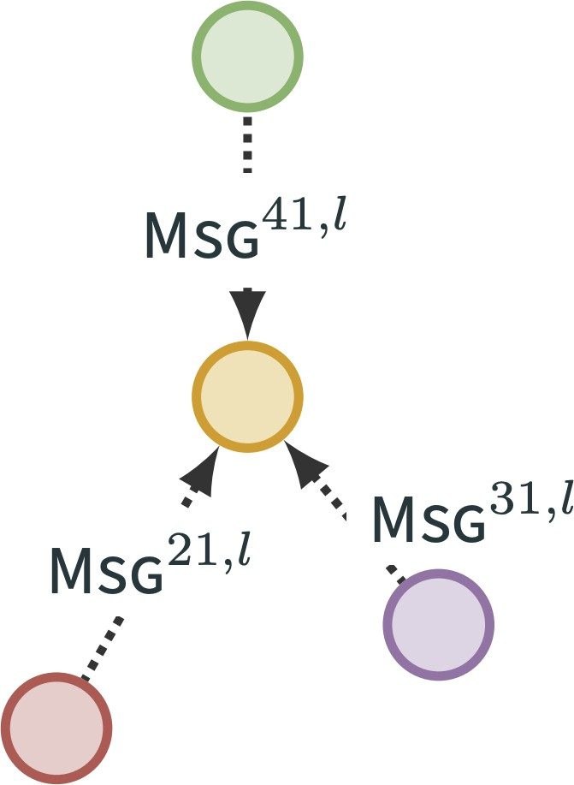
Transferability of STGNNs
Learning in Non-Stationary Environments
Global STGNNs are inductive and can directly be used in the above settings, provided that the training and target data are similar enough.
MP operates on generic neighborhoods
MP parameters are shared across nodes
Otherwise, STGNNs need to be adjusted
fine-tuning (a subset of) the weights of the model on the new data
exploiting transfer learning strategies
Enc
STMP
Dec
A Global-local STGNNs reduce the cost of transfer learning
sharing most of the parameters and finetuning node-specific parameters only
node embeddings can be regularized to facilitate the learning further.
[26] G. Panagopoulos et al., “Transfer graph neural networks for pandemic forecasting”, AAAI 2021.
[27] T. Mallick et al., “Transfer learning with graph neural networks for short-term highway traffic forecasting”, ICPR 2021.
[14] A. Cini et al., “Taming Local Effects in Graph-based Spatiotemporal Forecasting”, To appear in NeurIPS 2023.

Slide 75
Scalability

Slide 76
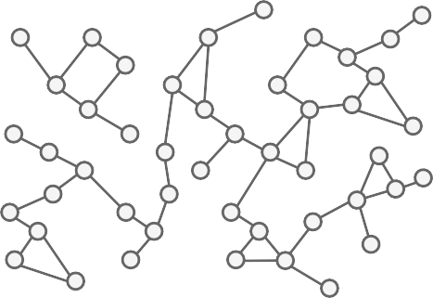
The scalability feature
Scalability
⌣ Graph-based processing allows us to learn a single model...
⌣ ...able to deal with a large collection of time series...
⌣ ...while accounting for the most relevant
relational information.

Slide 77
The scalability issue
Scalability
Spatiotemporal data span – as the name suggests – two dimensions:
the spatial dimension, corresponding to the number of time series (sensors).
the time dimension, corresponding to the number of time steps (number of observations acquired per sensor).
In the real world, dealing with thousands of sensors acquiring data at high sampling rates is quite common (e.g., smart cities).
⌢ A large amount of data needs to be processed at once.
⌢ In particular, to account for long-range spatiotemporal dependencies.

Slide 78
Computational complexity of STGNNs
Scalability
The computational complexity of T&S models is given by:
node-wise temporal processing – O^{t}WN ⁾;
→ O^{t}W ^{t}N + L|E_{t}|⁾⁾
L MP layers for each time step – O^{t}WL|E_{t}|⁾.
A first step toward improving scalability is represented by TTS models, which perform:
node-wise temporal processing – O^{t}WN ⁾;
→ O^{t}WN + L|E_{t}|⁾
L MP layers at the last time step – O^{t}L|E_{t}|⁾.
STT models, instead, do not have computational advantages over T&S models.

Slide 79

Graph subsampling
Scalability
Computations can be reduced by training on subgraphs of the full network, e.g., by
sampling the K-th order neighborhood of a subset of nodes;
rewiring the graph to reduce the total number of edges.
Mostly adapted from methods developed in static graph processing (e.g., [28], [29]).
⌢ Subsampling might break long-range spatiotemporal dependencies.
⌢ The learning signal may be noisy.
W. Hamilton et al., “Inductive representation learning on large graphs”, NeurIPS 2017.
Y. Rong et al., “DropEdge: Towards Deep Graph Convolutional Networks on Node Classification”, ICLR 2020.

Slide 80
Pre-computation
Scalability
Pre-processing methods (e.g., [30]) enable scalability to large graphs by:
precomputing a representation for each node’s neighborhood ahead of training;
processing the obtained node representations as if they were i.i.d. samples.
An extension to spatiotemporal data is given by SGP [31], which acts in 2 steps:
obtain a temporal encoding at each time step with a deep echo state network²;
propagate such encodings through the graph using powers of a graph shift operator.
F. Frasca et al., “SIGN: Scalable inception graph neural networks” 2020.
A. Cini et al., “Scalable Spatiotemporal Graph Neural Networks”, AAAI 2023.
² A randomized recurrent neural networks
69

Slide 81
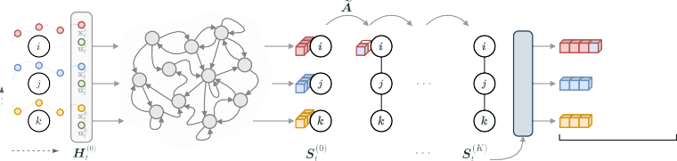
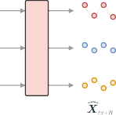
SGP: Scalable Graph Predictor [31]
Scalability
Extracted representations can be sampled uniformly across time and space during training.
. . .
. . .
. . .
CONCATENATE
MLP
space
time
Echo State Network
⌣ The cost of a training step is independent of W, N and |E_{t}|.
⌣ Performance matches state of the art.
⌢ More storage space is required, as the number of extracted features is much higher than d_{x}.
⌢ More reliant on hyperparameter selection than end-to-end approaches.
[31] A. Cini et al., “Scalable Spatiotemporal Graph Neural Networks”, AAAI 2023.

Slide 82
Dealing with missing data

Slide 83
The problem of missing data
Dealing with missing data
So far, we assumed to deal with complete sequences, i.e., to have valid observations associated with each node (sensor) and time step.
However, time series collected by real-world sensor networks often have missing data, due to:
faults, of either transient or permanent nature;
asynchronicity among the time series;
communication errors...
Most forecasting methods operate on complete sequences.
→ We need a way to impute, i.e., reconstruct, missing data.

Slide 84
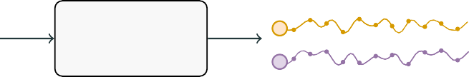
Time series imputation (i)
Dealing with missing data
The problem of reconstructing missing values in a sequence of data is often referred to as time series imputation (TSI).
Xt:t+T X⁻⁻⁻⁻t:t+T
TSI Method
time
time

Slide 85
Time series imputation (ii)
Dealing with missing data
i
We use a mask m ∈ {
0, 1} to distinguish between missing (0) and valid (
1) observations.
t
_{x}i
_{m}i
t:t+T
time
t:t+T
time
Time series imputation
Given a window of T ≥ 1 observations X_{<T} with missing values, the time series imputa- tion problem consists in estimating the missing observations in the sequence
i i
i
x ∼ p(x | X
) ∀ i, t such that m = 0
t t <T t
with X
i
i
i
<T
= {x |
x ∈ X and m = 1} being the observed set.
t
t <T
t

Slide 86
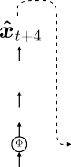
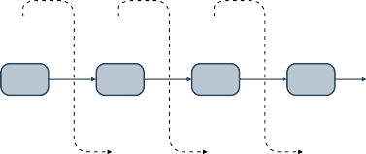
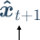
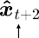
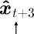
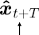
Deep learning for TSI
Dealing with missing data
Besides standard statistical methods, deep learning approaches have become a popular alternative, in particular, autoregressive models (e.g., RNNs).
RNN
RNN
RNN
RNN
RNN
1
MUX
0
1 0 0
⌣ Effective in exploiting past (and future, with bidirectional models) node observations...
⌢ ...but struggle in capturing nonlinear space-time dependencies.

Slide 87
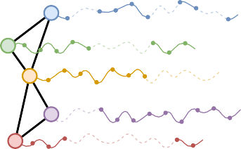

Time series imputation + relational inductive biases
Dealing with missing data
Again, we can use the available relational information to condition the model, i.e.,
t )
i i
x ∼ p x | X
, A
t t <T
As done for the forecasting problem, we can use STGNNs to address the imputation task.
Xt:t+T , A X⁻⁻⁻⁻t:t+T
TSI STGNN
time
time

Slide 88
Graph Recurrent Imputation Network
Dealing with missing data
Cini et al. [32] propose a GCRNN that builds upon the autoregressive approach for imputation:
A (graph-based) RNN (i.e., a GCRNN cell) is used to encode the sequence of only valid observations:
Z_{t} = STMP (H_{<t} ⊙ M_{<t}, E_{<t}) .
An additional MP layer is used as spatial decoder, to account for concurrent observations at neighbors:
(
{
o
i i
j j
x� = DEC z , AGGR MSG
(z , x ) .
t
^{t} j∈N (i)\{i}
t t
[32] A. Cini et al., “Filling the G_ap_s: Multivariate Time Series Imputation by Graph Neural Networks”, ICLR 2022.

Slide 89
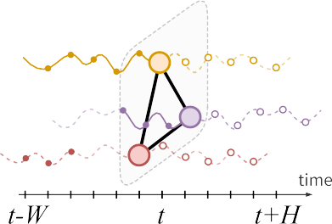
Forecasting from Partial Observations
Dealing with missing data
A more direct approach to the problem is to avoid the reconstruction step and consider forecasting architecture that can directly deal with irregular observations.
The mechanisms used in imputation models can be adapted to build forecasting architectures.
⌣ Such models can be used to jointly impute missing observations and forecast future values.

Slide 90
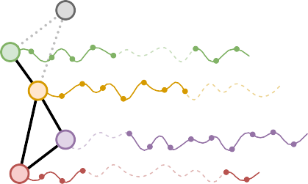
Beyond imputation
Dealing with missing data
Graph-based imputation methods estimate missing values at an existing node by using available information at neighboring nodes.
?
Question:
Can we use the same approach to infer observations of virtual sensors, i.e., fictitious nodes not associated with an existing sensor?
time

Slide 91
Virtual sensing
Dealing with missing data
'Q Simulate the presence of a sensor by adding a node with no data, then let the model infer the corresponding time series.
Two virtual sensors for air quality. (from [32])
Clearly, several assumptions are needed
high degree of homogeneity of sensors,
capability to reconstruct from observations at neighboring sensors,
and many more...
Truth GRIN
PM2.5 (µg/m³) PM2.5 (µg/m³)
200
no. 1014
100
150
100
50
no. 1031
Jun−19
12 : 00
Jun−20 12 : 00 2014−Jun−20
[10] I. Marisca et al., “Learning to Reconstruct Missing Data from Spatiotemporal Graphs with Sparse Observations”, NeurIPS 2022.
[32] A. Cini et al., “Filling the G_ap_s: Multivariate Time Series Imputation by Graph Neural Networks”, ICLR 2022.
[33] Y. Wu et al., “Inductive Graph Neural Networks for Spatiotemporal Kriging”, AAAI 2021.

Slide 92
Coding Spatiotemporal GNNs

Slide 93

tsl: PyTorch Spatiotemporal Library
Coding Spatiotemporal GNNs
tsl (Torch Spatiotemporal) is a python library built upon PyTorch and PyG to accelerate research on neural spatiotemporal data processing methods, with a focus on Graph Neural Networks.
. . . . . . . . . . . . . . . . . . . . . . . . . . . . . . . . . . . . . . . . . . . . . . . . . . . . . . . . . . . . . . . . . . . . . . . . . . . . . . . . . . . . . . . . . .
Notebook
Spatiotemporal Graph Neural Networks with tsl
Open in Colab

Slide 94
Conclusions

Slide 95
Some Takeaways
Conclusions
DL for time series
+
DL on graphs
Spatiotemporal Graph Neural Networks
=⇒
⌣ Relational inductive biases allow for exploiting dependencies among the time series
⌣ while sharing most of the model parameters
⌣ Global-local STGNNs are a safe choice in non-inductive settings
Challenges
< latent graph learning
a missing data imputation
ft inductive learning
1 scalability

Slide 96





Ivan Marisca
Andrea Cini Daniele Zambon Cesare Alippi
Graph Machine Learning Group
gmlg.ch

Slide 97
THE END
Questions?

Slide 98
References i
K. Benidis, S. S. Rangapuram, V. Flunkert, et al., “Deep learning for time series forecasting: Tutorial and literature survey,” ACM Comput. Surv., vol. 55, no. 6, 2022, ISSN: 0360-0300. DOI: 10.1145/3533382. [Online]. Available: https://doi.org/10.1145/3533382.
D. Bacciu, F. Errica, A. Micheli, and M. Podda, “A gentle introduction to deep learning for graphs,” Neural Networks, vol. 129, pp. 203–221, 2020.
M. M. Bronstein, J. Bruna, T. Cohen, and P. Veličković, “Geometric deep learning: Grids, groups, graphs, geodesics, and gauges,” arXiv preprint arXiv:2104.13478, 2021.
A. Cini, I. Marisca, D. Zambon, and C. Alippi, “Graph deep learning for time series forecasting: A comprehensive methodological framework,” arxiv, 2023.
J. Gilmer, S. S. Schoenholz, P. F. Riley, O. Vinyals, and G. E. Dahl, “Neural message passing for quantum chemistry,” in
International conference on machine learning, PMLR, 2017, pp. 1263–1272.
J. Chung, C. Gulcehre, K. Cho, and Y. Bengio, “Empirical evaluation of gated recurrent neural networks on sequence modeling,” arXiv preprint arXiv:1412.3555, 2014.

Slide 99
References ii
Y. Seo, M. Defferrard, P. Vandergheynst, and X. Bresson, “Structured sequence modeling with graph convolutional recurrent networks,” in International Conference on Neural Information Processing, Springer, 2018, pp. 362–373.
Y. Li, R. Yu, C. Shahabi, and Y. Liu, “Diffusion convolutional recurrent neural network: Data-driven traffic forecasting,” in
International Conference on Learning Representations, 2018.
B. Yu, H. Yin, and Z. Zhu, “Spatio-temporal graph convolutional networks: A deep learning framework for traffic forecasting,” in Proceedings of the 27th International Joint Conference on Artificial Intelligence, 2018, pp. 3634–3640.
I. Marisca, A. Cini, and C. Alippi, “Learning to reconstruct missing data from spatiotemporal graphs with sparse observations,” in Advances in Neural Information Processing Systems, 2022.
Z. Wu, D. Zheng, S. Pan, Q. Gan, G. Long, and G. Karypis, “Traversenet: Unifying space and time in message passing for traffic forecasting,” IEEE Transactions on Neural Networks and Learning Systems, 2022.
M. Sabbaqi and E. Isufi, “Graph-time convolutional neural networks: Architecture and theoretical analysis,” arXiv preprint arXiv:2206.15174, 2022.
[10]
[11]
[12]

Slide 100
References iii
[13]
P. Montero-Manso and R. J. Hyndman, “Principles and algorithms for forecasting groups of time series: Locality and globality,” International Journal of Forecasting, vol. 37, no. 4, pp. 1632–1653, 2021.
A. Cini, I. Marisca, D. Zambon, and C. Alippi, “Taming local effects in graph-based spatiotemporal forecasting,” arXiv preprint arXiv:2302.04071, 2023.
JRM Hosking, “Equivalent Forms of the Multivariate Portmanteau Statistic,” Journal of the Royal Statistical Society: Series B (Methodological), vol. 43, no. 2, pp. 261–262, 1981.
Z. Li, C. Lam, J. Yao, and Q. Yao, “On Testing for High-Dimensional White Noise,” The Annals of Statistics, vol. 47, no. 6,
pp. 3382–3412, 2019.
A. Bose and W. Hachem, “A Whiteness Test Based on the Spectral Measure of Large Non-Hermitian Random Matrices,” in
ICASSP 2020-2020 IEEE International Conference on Acoustics, Speech and Signal Processing (ICASSP), IEEE, 2020,
pp. 8768–8771.
P. A. P. Moran, “Notes on Continuous Stochastic Phenomena,” Biometrika, vol. 37, no. 1/2, pp. 17–23, 1950, ISSN: 0006-3444. DOI: 10.2307/2332142.
[14]
[15]
[16]
[17]
[18]

Slide 101
References iv
[19]
A. D. Cliff and K. Ord, “Spatial Autocorrelation: A Review of Existing and New Measures with Applications,” Economic Geography, vol. 46, pp. 269–292, 1970, ISSN: 0013-0095. DOI: 10.2307/143144.
D. Zambon and C. Alippi, “AZ-whiteness test: A test for signal uncorrelation on spatio-temporal graphs,” in Advances in Neural Information Processing Systems, A. H. Oh, A. Agarwal, D. Belgrave, and K. Cho, Eds., 2022.
D. Zambon and C. Alippi, “Where and how to improve graph-based spatio-temporal predictors,” arXiv preprint arXiv:2302.01701, 2023.
A. Cini, D. Zambon, and C. Alippi, “Sparse graph learning from spatiotemporal time series,” Journal of Machine Learning Research, vol. 24, no. 242, pp. 1–36, 2023.
Z. Wu, S. Pan, G. Long, J. Jiang, and C. Zhang, “Graph wavenet for deep spatial-temporal graph modeling,” in Proceedings of the 28th International Joint Conference on Artificial Intelligence, 2019, pp. 1907–1913.
T. Kipf, E. Fetaya, K.-C. Wang, M. Welling, and R. Zemel, “Neural relational inference for interacting systems,” in
International conference on machine learning, PMLR, 2018, pp. 2688–2697.
[20]
[21]
[22]
[23]
[24]

Slide 102
References v
[25]
G. Ditzler, M. Roveri, C. Alippi, and R. Polikar, “Learning in nonstationary environments: A survey,” IEEE Computational Intelligence Magazine, vol. 10, no. 4, pp. 12–25, 2015.
G. Panagopoulos, G. Nikolentzos, and M. Vazirgiannis, “Transfer graph neural networks for pandemic forecasting,” in
Proceedings of the AAAI Conference on Artificial Intelligence, vol. 35, 2021, pp. 4838–4845.
T. Mallick, P. Balaprakash, E. Rask, and J. Macfarlane, “Transfer learning with graph neural networks for short-term highway traffic forecasting,” in 2020 25th International Conference on Pattern Recognition (ICPR), IEEE, 2021,
pp. 10 367–10 374.
W. Hamilton, Z. Ying, and J. Leskovec, “Inductive representation learning on large graphs,” Advances in neural information processing systems, vol. 30, 2017.
Y. Rong, W. Huang, T. Xu, and J. Huang, “Dropedge: Towards deep graph convolutional networks on node classification,” in International Conference on Learning Representations, 2020.
F. Frasca, E. Rossi, D. Eynard, B. Chamberlain, M. Bronstein, and F. Monti, “SIGN: Scalable inception graph neural networks,” arXiv preprint arXiv:2004.11198, 2020.
[26]
[27]
[28]
[29]
[30]

Slide 103
References vi
[31]
A. Cini, I. Marisca, F. M. Bianchi, and C. Alippi, “Scalable spatiotemporal graph neural networks,” Proceedings of the AAAI Conference on Artificial Intelligence, vol. 37, no. 6, pp. 7218–7226, Jun. 2023. DOI: 10.1609/aaai.v37i6.25880.
A. Cini, I. Marisca, and C. Alippi, “Filling the g_ap_s: Multivariate time series imputation by graph neural networks,” in International Conference on Learning Representations, 2022. [Online]. Available: https://openreview.net/forum?id=kOu3-S3wJ7.
Y. Wu, D. Zhuang, A. Labbe, and L. Sun, “Inductive Graph Neural Networks for Spatiotemporal Kriging,” in Proceedings of the AAAI Conference on Artificial Intelligence, vol. 35, 2021, pp. 4478–4485.
[32]
[33]

